Slide 1
New Café Locations in Visakhapatnam
Investment Region Analysis for DS Capstone Project
Isaac Injeti
Jan 14th, 2019

Slide 2
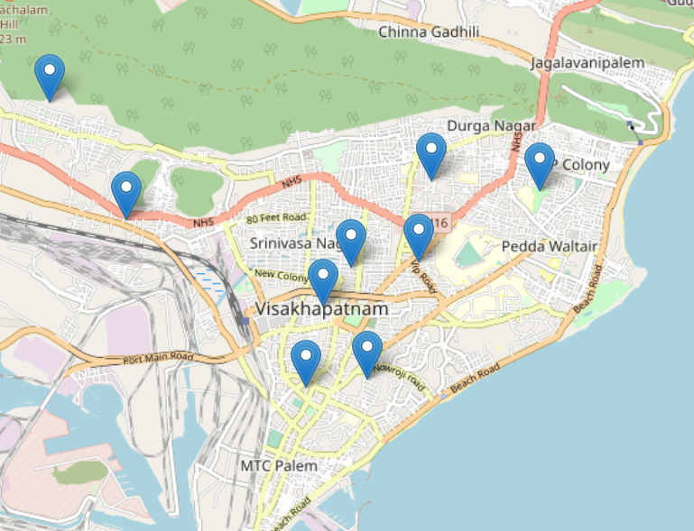
Problem Statement
New Café ventures have been failing in various locations and investors need to know what characteristics make up the regions in which the most successful cafes currently operate so that a better decision can be made for the location of their new café in Visakhapatnam, AP India.

Slide 3
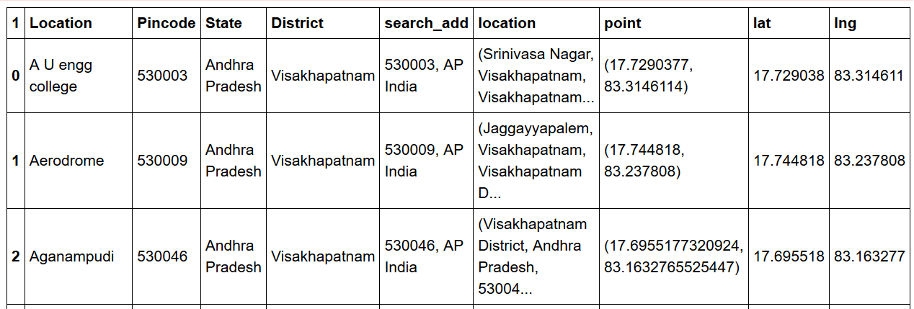
Data
Target Area data from Wikipedia
Zip Codes of each area to capture geo coordinates
Foursquare venue data based on coordinates

Slide 4
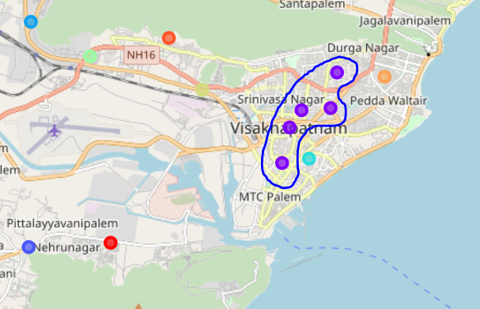
Methodology
Clustering of venue categories from each area using the k-means algorithm
Visualization of regions
Recommendation based on cluster and correlated venue categories

Slide 5
Results & Conclusion
Existing cafes found to be in same cluster
The Top Café is Café Coffee Day- The Lounge and is located in the A.U. Eng College area
'Breakfast Spot', 'Convenience Store', 'Fabric Shop', 'Snack Place' were the categories of venues most commonly associated to the Top Café cluster
Akkayyapalem, P&T Colony, and Visakhapatnam (central) are the areas in which investors may have greater success based on similarity to the area in which the Top Café was located

